Slide 1
Web Applications
INFWEB01-D and INFWEB21-D

Slide 2
Motivation
Implementing reliable software can be a difficult process, why?
Notes:
- How are applications that run locally setup? Code, files and database are on the same machine
- Such a process is usually separated into phases to improve detecting errors for each implemented components
- Beside errors that are produces by programming the software itself others could be made through configuring or programming the network and infrastructure
- In order to detect errors correctly additional knowledge about networking and Infrastructure is needed.

Slide 3
Motivation
Recent development of web applications and the infrastructure around it has implication on the design and the implementation of software
With recent development we mean cloud computing:
Infrastructure as a service IaaS (for example hardware)
Platform as a service PaaS (for example a servers)
Software as a service SaaS (for example web shops)
How is this development implicating the application development?

Slide 4
Networking
What is a computer network?
Notes:
Computer network is a telecommunications network which allows computers to exchange data
Data are transmitted as a bit of streams or as a network packet that is a formatted unit of data (a list of bits or bytes)

Slide 5
Networking
What is a computer network?
Networks are characterized through their organizational purpose:
Local area network (LAN) which is usually limited to a building
Wide area network (WAN) which extends over a large geographical distance
Virtual Private network (VPN) which uses tunneling to connect to another network
How are data transmitted in the network?
Notes:
Computer network is a telecommunications network which allows computers to exchange data
Data are transmitted as a bit of streams or as a network packet that is a formatted unit of data (a list of bits or bytes)

Slide 6
Network topologies
A network topologie is a graph structure used to connect/link different nodes to create a network
Nodes could be any hardware components such as hosts, switches, servers, routers, printers etc) that are connected/linked
Every topology shown above has it’s own dis-/advantages
For example in a star topology the fail of the central node breaks the connection completely
Data in the network are transmitted through one or the combination of different topologies

Slide 7
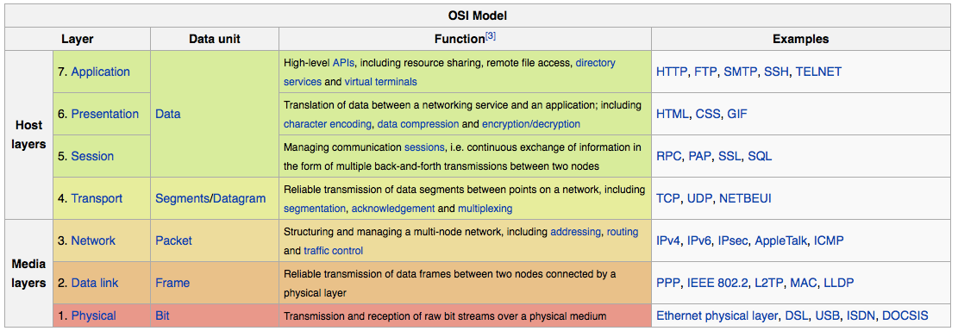
OSI model
Open Systems Interconnection model (OSI model)
It is a conceptual model that characterizes and standardizes the communication of a telecommunication or computing system
Consist of 7 layers, each layer adds more information to the header of the package that is been sent from a host to another one

Slide 8
Network Layers and Data Flows
Internet protocol suite IP/TCP provides end-to-end data communication
This functionality is organized into four abstraction layers
Notes:
A voip call uses typically a UDP connection.
The data flows in the networks starting from host one (A) until it reaches host (B)
It might flow through some routers between host (A) and (B)

Slide 9
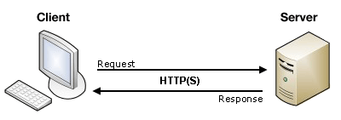
Client-Server Architecture
Web applications is a client–server computer program
A server node runs one or more server programs which share their resources with clients
A client node does not share any of its resources, but requests a server's content or service function
Notes:
A distributed application structure is a partition of the tasks or workloads between servers, and service requesters, called clients

Slide 10
Network Protocols
Client-server communication is implemented using different network protocols.
What is the function of a protocol?
Notes:
Your application must respect the specification of the used protocols.
An example of such used protocols are IP, TCP, UPD, HTTP
We will look closer to some protocols in the following slides.
Syntax (data format and coding)
Semantics (control information and error handling)
Timing (speed matching and sequencing)

Slide 11
Network Protocols
Client-server communication is implemented using different network protocols.
What is the function of a protocol?
Notes:
Your application must respect the specification of the used protocols.
An example of such used protocols are IP, TCP, UPD, HTTP
We will look closer to some protocols in the following slides.
Syntax (data format and coding)
Semantics (control information and error handling)
Timing (speed matching and sequencing)

Slide 12
Internet protocol
IP has the task of delivering packets from the source node to the destination node
How is this delivery established?
Why do we need such a protocol?
There are two versions of it?
IPv4
Since 1981
32 bit
Decimal / 4 groups of 3 digits
Notes:
Delivery established through IP address
IP also defines addressing methods that are used to label the datagram with source and destination information

Slide 13
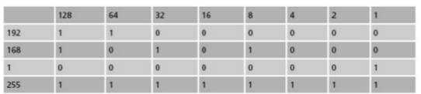
IPv4 sample
Consider having the following private IP address for a machine:
192.168.1.255
The IP address is represented through the following binary code
11000000.10101000.00000001.11111111

Slide 14
Subnet mask
To match physical layout (e.g. Sales, production, etc.)
To match administrative layout (e.g. Managers, staff, etc.)
To plan for growth
To reduce network traffic
Examples
A 255.0.0.0 first byte is fixed
B 255.255.0.0 first two bytes are fixed
C 255.255.255.0 first three bytes are fixed
Subnets are used to determine the address is local or remote

Slide 15
IPv6
128 bit (as mac-addresses of machines)
Hexadecimal (base 16 or hex)
Not interoperable with IPv4
Improves some limitation of IPv4 such as:
Exhausting IPv4 addresses
improve IPv4 routing through changing the package structure
The packet header in IPv6 is simpler than the IPv4 header. Many rarely used fields have been moved to optional header extension
Example FE80:0000:0000:0000:0202:B3FF:FE1E:8329

Slide 16
Transport layer protocols UPD vs TCP
User datagram protocol(UDP)
It uses a simple connectionless transmission.
It has no handshaking dialogues
Transmission control protocol(TCP)
It sends the byte stream in a reliable, ordered way
It has an error-checking mechanism of sending packages
Example of usage within application:
UDP: video or audio streaming
TCP: FTP file transfer or HTTP connections

Slide 17
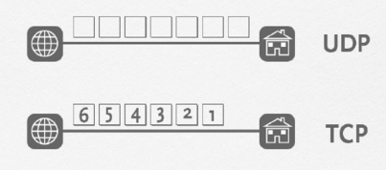
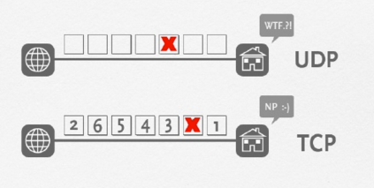
TCP vs. UDP

Slide 18
Question
What are the basic ingredients of a web application?

Slide 19
Web Applications
The basic ingredients of a web application are:
Protocols: in addition to IP/TCP or IP/UDP it uses HTTP (Hypertext Transfer Protocol)
Component files:
Code files: websites are built primarily from HTML, CSS, and JavaScript. Other programming languages (C#, Java, etc.) could be used to generate the website.
Assets/Resources: this is a collective name for all the other stuff that makes up a website
Servers: web server and databases if necessary
Notes:
HTTP is an application protocol that defines a language for clients and servers to speak to each other. This is like the language you use to order your goods.
:A website is made up of many different files, which are like the different parts of the goods you buy from the shop. These files come in two main types: Code files, Assets
Assets: such as images, music, video, Word documents, and PDFs.

Slide 20
Example of Client-Server Implementation
Suppose we use Postman application to connect the following URL: https://jsonplaceholder.typicode.com/posts
What are the two ends of this communications?
Can you describe the functionalities provided at each end?

Slide 21
Question
What is the difference between dynamic and static web applications?
How would you separate the functionality of your application for simultaneous development and code reuse?

Slide 22
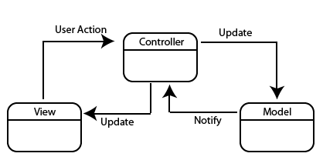
Model-View-Controller (MVC)
Many modern web applications use the MVC architectural pattern to allow:
simultaneous development,
and code reuse
The main idea is to partition an applications into three parts:
The Model
The View
the Controller
What is the purpose of the Model?
Notes:
Motivation: Use divide and conquer to simplify among the parts of a program
- Defines the role the objects play in an application into one of three parts
- Defines the way objects communicate with each other

Slide 23
The Model in MVC
The central component of the pattern
It is the application's dynamic data structure, independent of the user interface
It directly manages the data and the logic to interact with a database provider
Notes:
Talk about the state of each component -> the state of the view could be different than the state of the model

Slide 24
The Model in MVC..
Two general ways to implement the Model:
Tightly coupling the data-access code to a database provider like MySQL using SQL
Adding another abstraction layer that is database provider independent using object-relational mapper (ORM)
In this course we will use the later by mean of using Entity Framework Core and Linq!

Slide 25
Introduction to Object-Relational Mapper
Modern approaches are based on a mapping between the data structures of the host programming language and those of the model
"O" because mainstream languages (C++, Java, C#) are still object-oriented

Slide 26
Introduction to Object-Relational Mapper..
ORM automatically translates tables into classes, columns into attributes, and classes and attributes back into tables and columns;
Models also feature relations between entities:
For instance 1-N relation, where one entity of a type is logically connected to many entities of another type
Example: Course 1 - N Lectures
EF Core uses two additional design pattern to minimize duplicate query logic when processing data
Repository pattern
Unit of work pattern

Slide 27
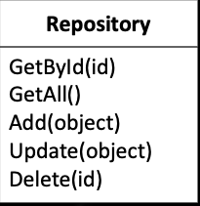
Repository Pattern
Repository encapsulates the set of objects persisted in a data store and the operations performed over them
It centralize common data access functionality
It encapsulate the logic required to access data source

Slide 28
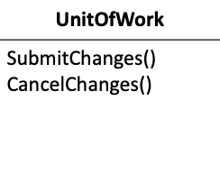
Unit of Works Pattern
When you're pulling data in and out of a database, it's important to keep track of what you've changed
A Unit of Work keeps track of everything you do during a transaction that can affect the database
It maintains a list of new, changed and deleted objects.
It coordinates persisting changes Can be used across multiple repositories

Slide 29
Repository and Unit of Works in EF Core
A DbContext instance represents a session with the database and can be used to query and save instances of your entities
DbContext is a combination of the Unit Of Work and Repository patterns

Slide 30
Live Example
Implement a console application for the movie database:
Relationship: movie 1<->N actor
Relationship: movie N<->N actor

